Slide 1
Disorders of peripheral nerves

Slide 2
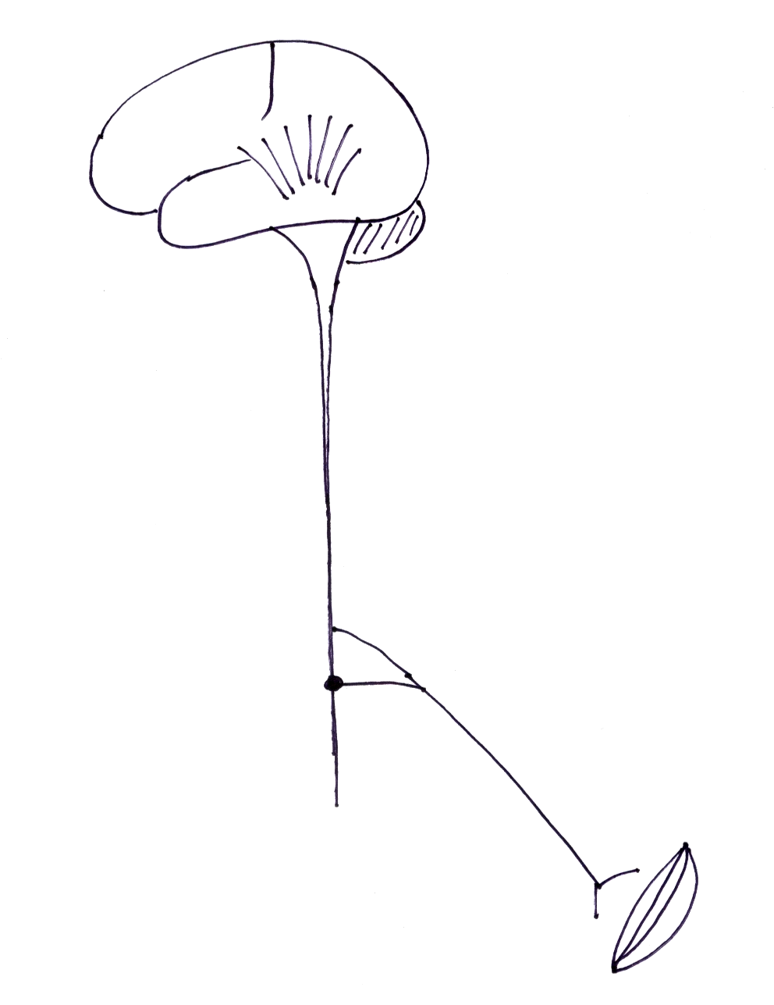
Peripheral nerve disease
distal signs
motor - LMN weakness
reflex loss
sensory loss
  large fibres - JPS, vibration
  small fibres - pain, temp.
autonomic
peripheral
nerve

Slide 3
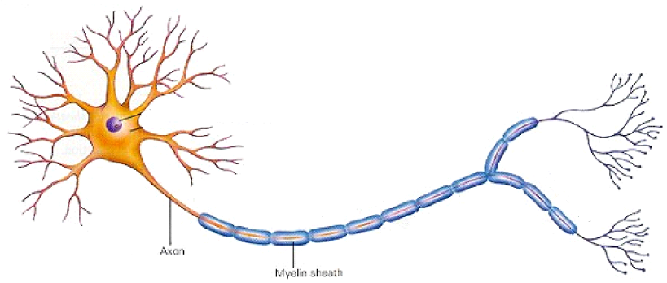
Peripheral nerve disease
demyelination
  loss of myelin, axon intact
axonal degeneration

Slide 4
Peripheral nerve disease - types
Mononeuropathy
‘Mononeuritis multiplex’
Polyneuropathy

Slide 5
Mononeuropathy
Trauma
Entrapment neuropathy
  median N. - carpal tunnel syndrome
  ulnar N. - cubital tunnel syndrome
  lateral cutaneous N. of the thigh - meralgia paraesthetica
  tibial N. - tarsal tunnel syndrome

Slide 6
Mononeuritis multiplex
diabetes
leprosy
vasculitis
connective tissue diseases
sarcoidosis

Slide 7
Polyneuropathy- causes
diabetes
alcohol
infections - leprosy, diphtheria, HIV, …
inflammatory - Guillain-Barre synd., CIDP
drugs - INAH, metronidazole, ….
other metabolic - B12 deficiency, CRF, porphyria, …
toxins - lead, organophosphates, …
hereditary - HMSN (Charcot-Marie-Tooth dis.)
paraneolastic
other ….

Slide 8
Polyneuropathy - clinical features

Slide 9
Polyneuropathy - clinical features
motor
sensory
autonomic

Slide 10
Polyneuropathy - clinical features
bilateral, symmetrical
distal weakness, wasting
reflexes - diminished or lost
numbness, cannot feel texture
  ‘feeling of mud on my soles’
  ‘walking on cotton wool’
pain, ‘pins & needles’, ‘burning’
‘glove & stocking’ sensory loss
  pain, touch, temperature
JPS loss - sensory ataxia, Romberg’s sign
thickened nerves - leprosy, HMSN, …

Slide 11
Polyneuropathy - clinical features…
autonomic neuropathy
CVS - postural hypotension loss of HR & BP variation with Valsalva
GIT - vomiting (gastroparesis), nocturnal diarrhoea
GUT - bladder - retention, incontinence erectile dysfunction
skin - loss of sweating

Slide 12
Peripheral nerve disease - investigation
Confirm peripheral nerve disease
  nerve conduction studies / electromyography - demyelination/ axonal degeneration
  nerve biopsy
Look for cause

Slide 13
Peripheral nerve disease - treatment
Symptomatic treatment - peripheral nerve disease
  Neuropathic pain –
    anti-depressants - tricyclics, …
    anti-epileptics - carbamazepine, gabapentin, pregabalin
  physiotherapy
Treat the cause

Slide 14
Guillain-Barre syndrome

Slide 15
GBS - pathophysiology

Slide 16
GBS - pathophysiology
immune response
infection organism
molecular mimicry
host neural tissues

Slide 17
GBS - pathophysiology
antecedent events
infection - viral - CMV, EBV, VZV, HIV
Campylobacter, mycoplasma
vaccines
molecular mimicry
shared antigens between pathogen &
surface glycolipids of peripheral nerves
immune mediated inflammatory poly-radiculo-neuropathy

Slide 18
GBS - pathophysiology
target epitopes
Schwann cell membrane or myelin
demyelination - AIDP
axonal membrane
axonal damage - axonal GBS
cerebellum, cranial nn. 3 4 6 , dorsal root ganglia
Miller- Fisher syndrome
ataxia, ophthalmoplegia, areflexia

Slide 19
GBS - clinical features

Slide 20
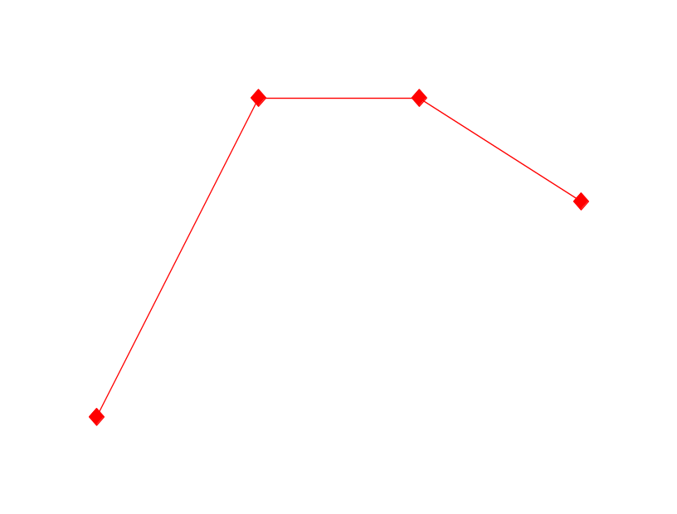
GBS - clinical features
acute flaccid areflexic paralysis
self - limiting
2/3 - trigger event
rapid progression - upto 4 weeks
plateau
recovery

Slide 21
GBS - clinical features
acute, symmetric, flaccid motor weakness
2 or more limbs - proximal, ascending
cranial nerves – facial, bulbar, ophthalmoplegia
respiratory
areflexic
sensory - symptoms common, signs few
autonomic - cardiovascular, bladder, bowel
pain - 1/3rd severe

Slide 22
GBS - diagnosis
Clinical
CSF - high protein (80%)
cells normal
‘protein-cellular dissociation’
NCS / EMG
  demyelination
  axonal degeneration
changes best seen after 10-14 days

Slide 23
Exclude - other causes of
acute flaccid paralysis

Slide 24
Exclude - other causes of
acute flaccid paralysis
poliomyelitis diphtheria
myasthenia botulism
paralytic rabies snake bite
porphyria
toxic neuropathy - OP
electrolyte imbalance

Slide 25
GBS - management
General
monitor – pulse, BP, RR, single breath count, vital capacity
1/3 - intensive care
Respiratory support - VC < 20 ml/kg
* no signs of breathlessness
Specific treatment - Immunomodulation
plasma exchange, IVIg - equally effective
* steroids - no benefit
Rehabilitation

